Slide 1
Retail e-commerce
- Ashwini, Hanika, Kavita, Mayuresh

Slide 2
OBSERVATION affecting sales
Column Observation | Non -Numeric | Blank | 0 Value | Special Char | Negative Values | Comments
Invoice | 9288 |  |  |  |  | Cancel orders
Stock Code | 2995 |  |  |  |  | Values like gift card
Description |  | 1454 |  | 68
Quantity |  |  |  |  | 1337
Unit Price |  |  | 2515 |  | 2
Customer ID |  | 135080
Country |  |  |  | 446 |  | Unspecified values

Slide 3
Sales Max benefited
Top Customer id -14611
Top Description-Dotcom Postage
Top Country- Uk
Top Stockcode-22423

Slide 4
SALES

Slide 5
Top 5 Countries with highest sales
COUNTRY | SALES(SUM)
United Kingdom | 8,187,806
Netherlands | 284,662
Germany | 221,698
France | 197,404
EIRE | 263,277

Slide 6
Top 5 stock Code with Highest Sales
STOCK CODE | SALES(SUM)
DOT | 206,245
22423 | 164,762
85123A | 99,847
47566 | 98,303
85099B | 92356

Slide 7
TOP 5 CUSTOMER ID WITH HIGHEST SALES
CUSTOMER ID | SALES(SUM) | COUNTRY
14646 | 279,489 | Netherlands
18102 | 256,438 | United Kingdom
17450 | 187,482 | United Kingdom
14911 | 132,573 | EIRE
12415 | 123,725 | Australia

Slide 8
Top 5 Description with highest sales
DESCRIPTION | SALES(SUM)
Dotcom Postage | 206,245
Regency Cakestand 3 Tier | 164,762
White Hanging Heart T-Light Holder | 99,668
Party Bunting | 98,303
Jumbo Bag Red Retrospot | 92,356

Slide 9
Top Year, Month and Day with highest sales
2011 | 2010
Sales : 8,998,791 | Sales : 748,957
November Sales : 1,461,756 | December Sales : 748,857
Day of Invoice Date : 14 Sales : 112,141 | Day of Invoice Date : 1 Sales : 58,636

Slide 10
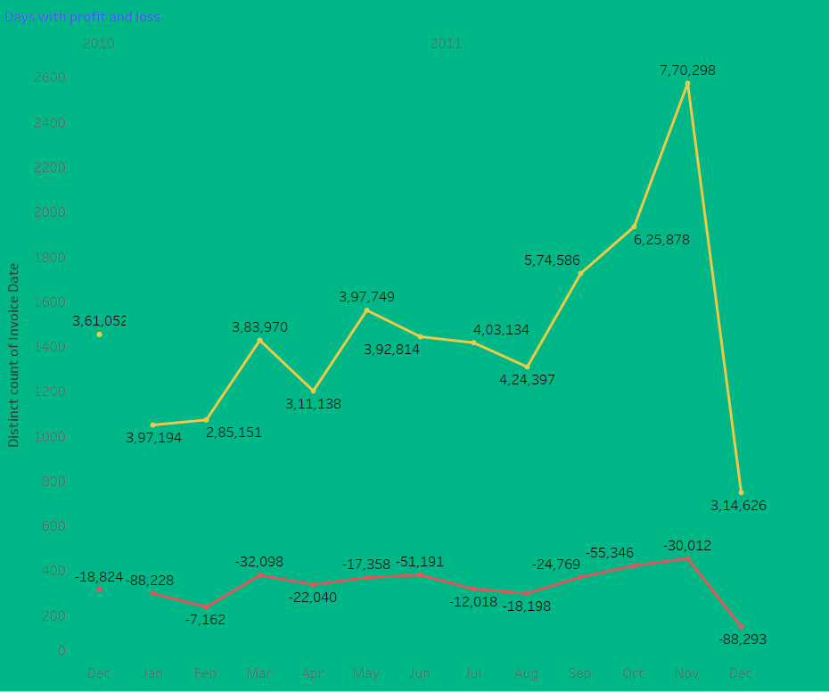
NOVEMBER HAS HIGHEST SALES PROFIT AND DECEMBER HAS THE HIGHEST LOSS

Slide 11
QUANTITY

Slide 12
Top 5 Stock Code with high quantity
STOCK CODE | QUANTITY(SUM)
85099B | 47,363
85123a | 39,122
20725 | 18,979
47566 | 18,022
22423 | 12,980

Slide 13
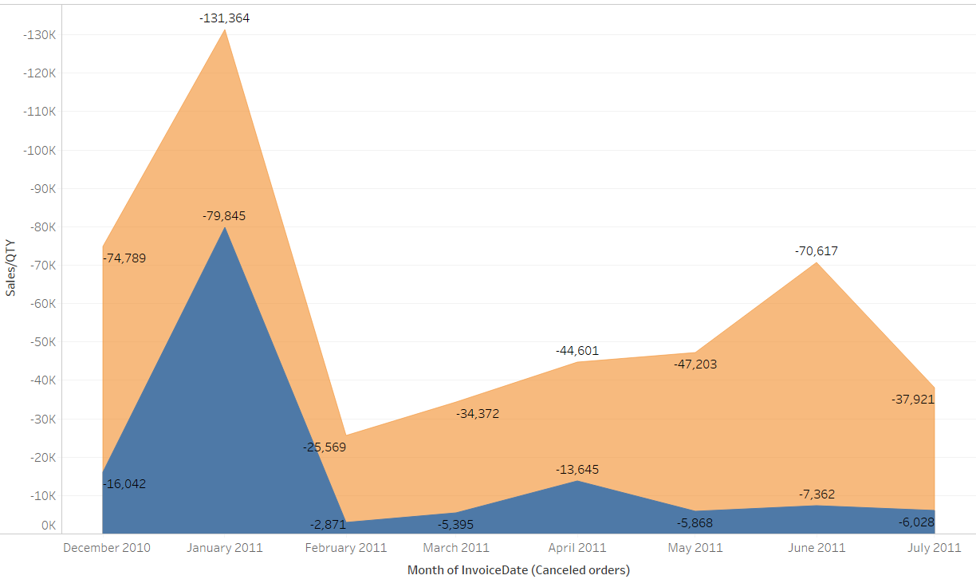
MONTHLY CANCELLED ORDERS
: Represents sales
: Represents Quantity

Slide 14
UNIT PRICE

Slide 15
TOP 5 COUNTRY WITH HIGHEST UNIT PRICE
COUNTRY | UNTI PRICE(SUM)
United Kingdom | 2,245,715
EIRE | 48,447
France | 43,032
Germany | 37,666
Singapore | 25,109

Slide 16
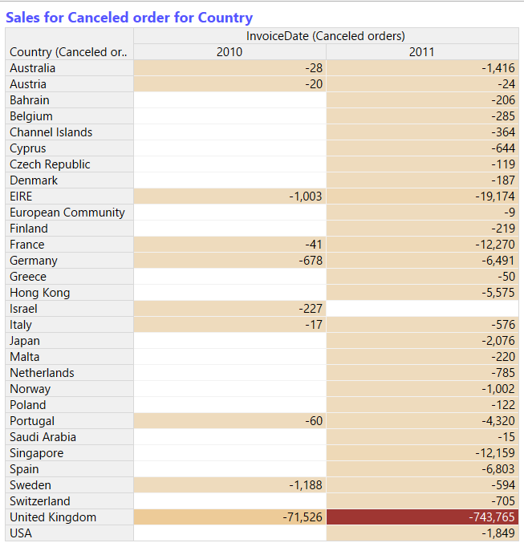
Sales of cancelled orders per country

Slide 17
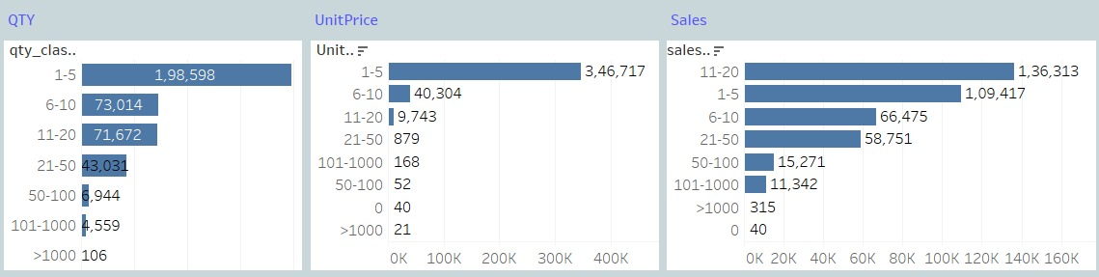
Order count as per range for qty, Price, Sales

Slide 18
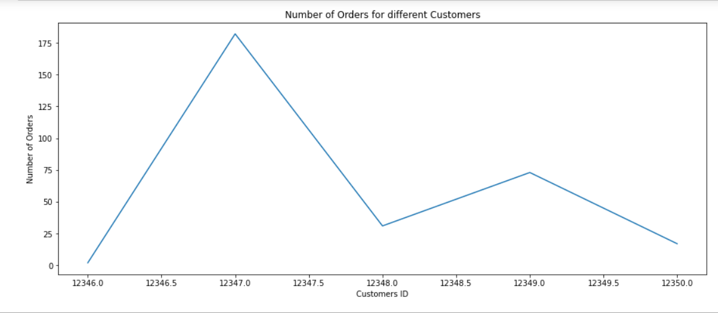
Customer ID -12347 have 182 orders and country as Iceland

Slide 19
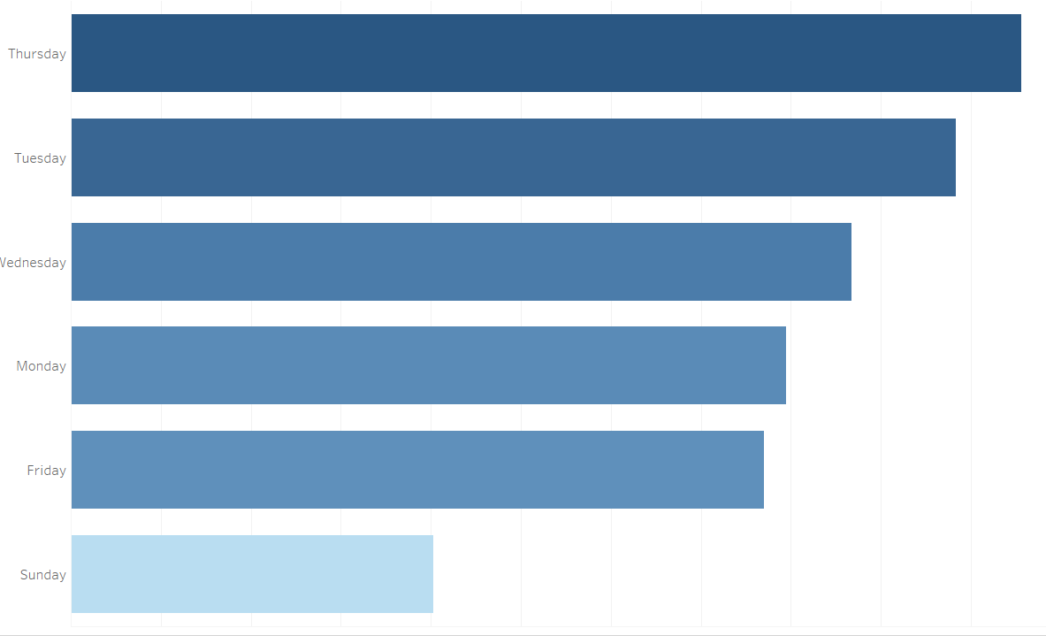
Thursdays have max sales

Slide 20
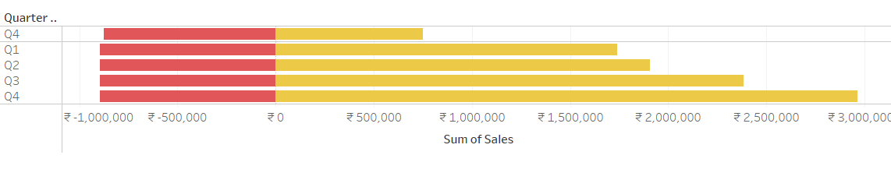
Quarterly sales and canceled orders
Cancel order sales value is almost consistent in all quarters

